Slide 1



Prematurity & Low Birth Weight
Dr. Hina Sattar
M.B;B.S (K.E), FCPS (Pediatrics)
Assistant Professor
Rawalpindi Medical University

Slide 2
Prematurity, LBW and IUGR
Management
Complications
Risk factors
Learning
Objectives

Slide 3
Low birth weight LBW
Preterm
IUGR
Birth weight of < 2500 g
< 37 weeks of gestation
birth weight < 10th centile for gestational age

Slide 4
Appropriate for gestational age AGA
Birth weight between 90th and 10th centile for gestational age
Large for gestational age LGA
Birth weight >90th centile for gestational age
Small for gestational age SGA
Birth weight <10th centile for gestational age

Slide 5
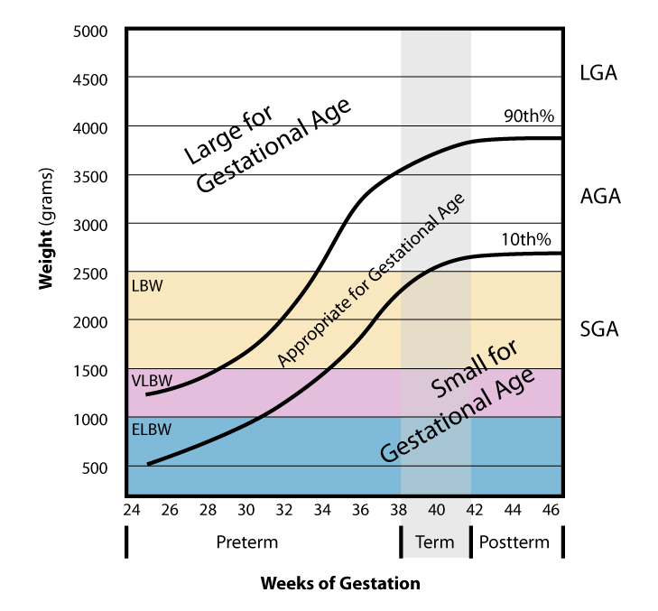

Slide 6
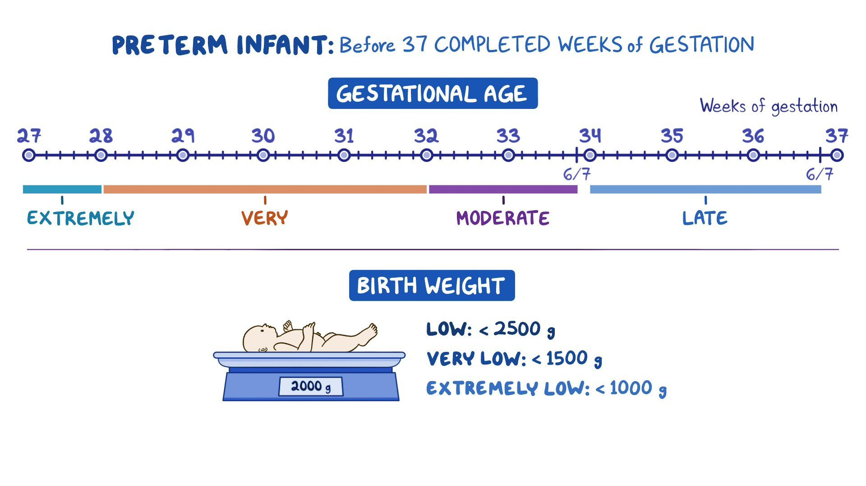

Slide 7
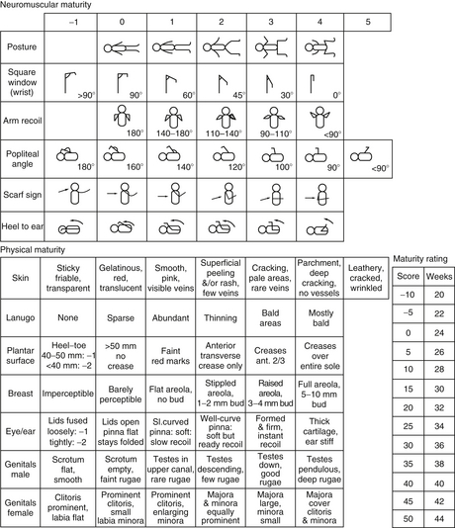
Ballard Scoring
Six parameters each:
Neuromuscular maturity
Physical maturity

Slide 8
Quick gestational age assessment
 | 36 wks & earlier | 37-38 wks | 39 wks & beyond
Creases in sole of feet | One or 2 transverse creases posterior ¾ of sole smooth | Multiple creases; anterior 2/3 of heel smooth | Entire sole, including heel covered with creases
Breast nodule | 2mm | 4mm | 7mm
Scalp hair | Fine & wooly; fuzzy | Fine & wooly; fuzzy | Coarse & silky; each hair single stranded
Earlobe | No cartilage | Moderate amount of cartilage | Stiff ear lobe with thick cartilage
Testes & scrotum | Testes partially descended; scrotum small with few rugae | Testes fully descended; scrotum normal size with prominent rugae | Testes fully descended; scrotum normal size with prominent rugae

Slide 9
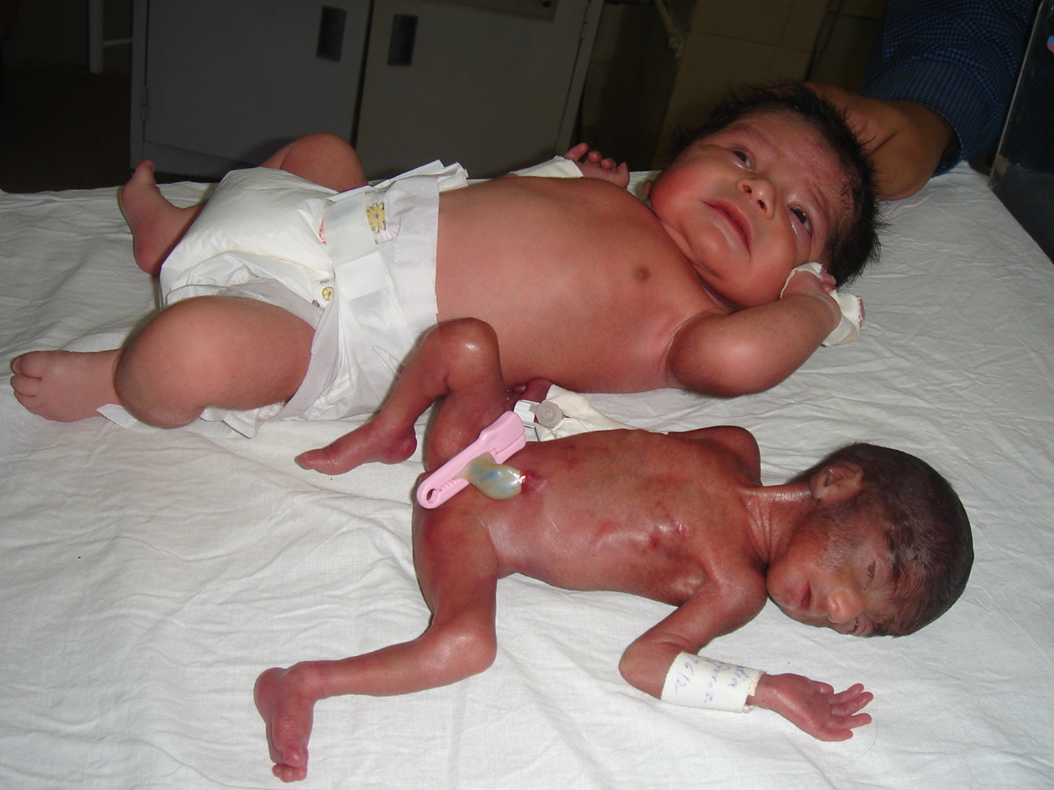

Slide 10
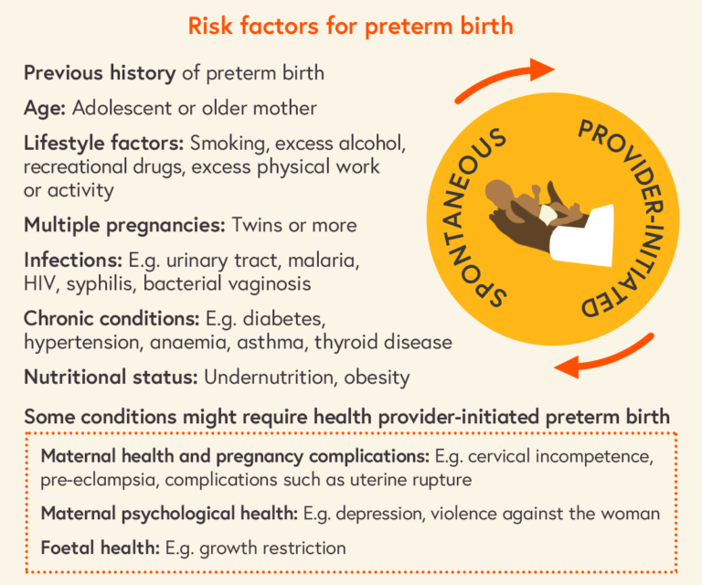
Prevalence of Prematurity and LBW in Pakistan
18-21% Premature in different studies as compared to 7% worldwide
>30% LBW one of the highest in the world (16% worldwide)
High neonatal mortality rate 58/1000 live births

Slide 11
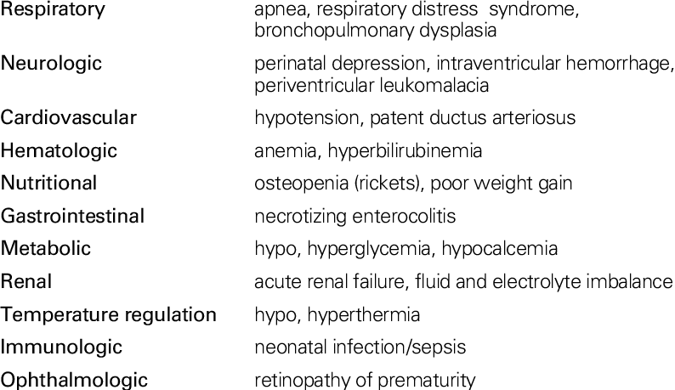
Complications of Prematurity & LBW

Slide 12
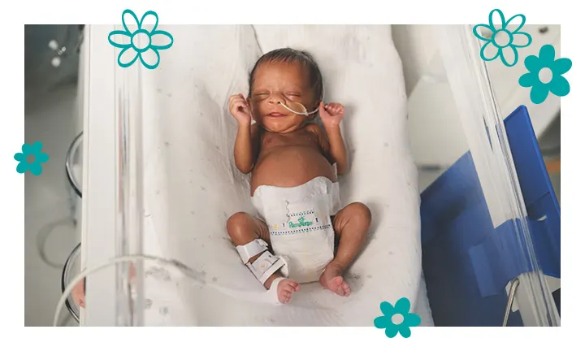
Management
Temperature and humidity
Fluid & Electrolyte
Glucose
Calcium
Nutrition
Respiratory support
Patent Ductus Arteriosus PDA
Infections
together for the babies born too soon…

Slide 13
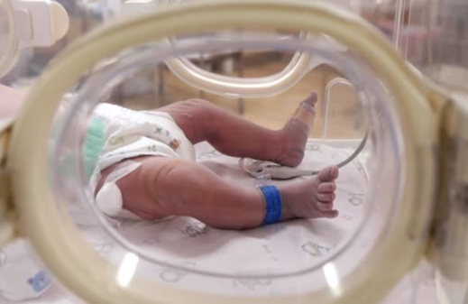
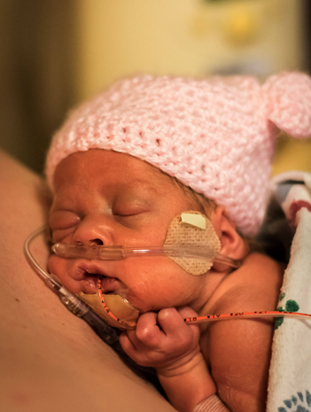
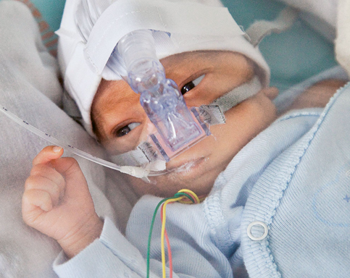
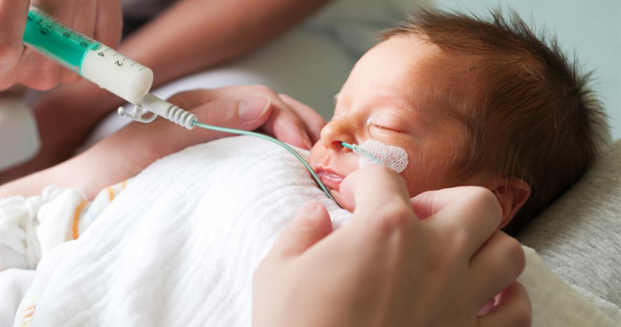

Slide 14


Slide 15
Discharge Criteria
*When the infant is feeding orally *Maintaining body temperature *Apneaº/ Bradycardiaº *Weight > 1800g & gaining weight 30g/d

Slide 16


Slide 17
